Slide 1
IPv6

Slide 2
outlines
IP Network Addressing
Classful IP addressing
Techniques to reduce address shortage in IPv4
Features of IPv6
Header Comparisons
Extension Headers
Conclusions

Slide 3
IP Network Addressing
INTERNET → world’s largest public data network, doubling in size every nine months
IPv4, defines a 32-bit address - 2³² (4,294,967,296) IPv4 addresses available
The first problem is concerned with the eventual depletion of the IP address space.
Traditional model of classful addressing does not allow the address space to be used to its maximum potential.

Slide 4
Classful Addressing
When IP was first standardized in Sep 1981, each system attached to the IP based Internet had to be assigned a unique 32-bit address
The 32-bit IP addressing scheme involves a two level addressing hierarchy
Network Number/Prefix
Host Number

Slide 5
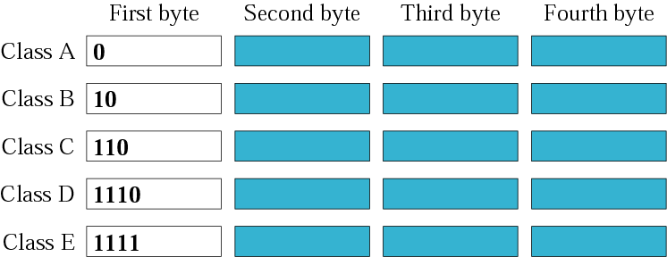
Classful Addressing…
Divided into 5 classes
Class A 8 bits N/W id and 24 bits host id and so on B,C.
Wastage of IP addresses by assigning blocks of addresses which fall along octet boundaries

Slide 6
Techniques to reduce address shortage in IPv4
Subnetting
Classless Inter Domain Routing (CIDR)
Network Address Translation (NAT)

Slide 7
Subnetting
Three-level hierarchy: network, subnet, and host.
The extended-network-prefix is composed of the classful network-prefix and the subnet-number
The extended-network-prefix has traditionally been identified by the subnet mask
Network-Prefix Subnet-Number Host-Number

Slide 8
Subnetting Example
128.10.1.1
H1
128.10.1.2
H2
Sub-network 128.10.1.0
Internet
G
All traffic
to 128.10.0.0
128.10.2.1
H3
128.10.2.2
H4
Net mask 255.255.0.0
Sub-network 128.10.2.0
Subnet mask 255.255.255.0

Slide 9
Classless Inter-Domain Routing
Eliminates traditional classful IP routing.
Supports the deployment of arbitrarily sized networks
Routing information is advertised with a bit mask/prefix length→ specifies the number of leftmost contiguous bits in the network portion of each routing table entry
Example: 192.168.0.0/21

Slide 10
CIDR Table Entry…
Extract the destination IP address.
Boolean AND the IP address with the subnet mask for each entry in the routing table.
The answer you get after ANDing is checked with the base address entry corresponding to the subnet mask entry with which the destination entry was Boolean ANDed.
If a match is obtained the packet is forwarded to the router with the corresponding base address

Slide 11

Network Address Translation
Each organization- single IP address
Within organization – each host with IP unique to the orgn., from reserved set of IP addresses
3 Reserved ranges
10.0.0.0 – 10.255.255.255 (16,777,216 hosts)
172.16.0.0 – 172.31.255.255/12 (1,048,576 hosts)
192.168.0.0 – 192.168.255.255/16 (65,536 hosts)

Slide 12
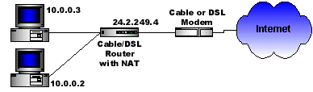
NAT Example
10.0.0.4
C
B
10.0.0.1
Source Computer | Source Computer's IP Address | Source Computer's Port | NAT Router's IP Address | NAT Router's Assigned Port Number
A | 10.0.0.1 | 400 | 24.2.249.4 | 1
B | 10.0.0.2 | 50 | 24.2.249.4 | 2
C | 10.0.0.3 | 3750 | 24.2.249.4 | 3
D | 10.0.0.4 | 206 | 24.2.249.4 | 4

Slide 13
Features of IPv6
Larger Address Space
Aggregation-based address hierarchy
– Efficient backbone routing
Efficient and Extensible IP datagram
Stateless Address Autoconfiguration
Security (IPsec mandatory)
Mobility

Slide 14
128-bit IPv6 Address
3FFE:085B:1F1F:0000:0000:0000:00A9:1234
8 groups of 16-bit hexadecimal numbers separated by “:”
Leading zeros can be removed
3FFE:85B:1F1F::A9:1234
:: = all zeros in one or more group of 16-bit hexadecimal numbers

Slide 15
Example 1…
How can you abbreviate the following IPv6 address?
  2001:0db8:0000:0000:0000:0000:0000:0c50
  A. 2001:0db8:0:0:0:0:0:0c50
  B. 2001:0db8::0c50
  C. 2001:db8::c50
  D. 2001:db8::c5
  (taken from http://www.ripe.net/lir-services/training/material)

Slide 16
Example 2…
How can you abbreviate the following IPv6 address?
  2001:0db8:0000:0000:b450:0000:0000:00b4
  A. 2001:db8::b450::b4
  B. 2001:db8::b450:0:0:b4
  C. 2001:db8::b45:0000:0000:b4
  D. 2001:db8:0:0:b450::b4
Note: 2001:db8::/32 is the reserved IPv6 documentation prefix

Slide 17
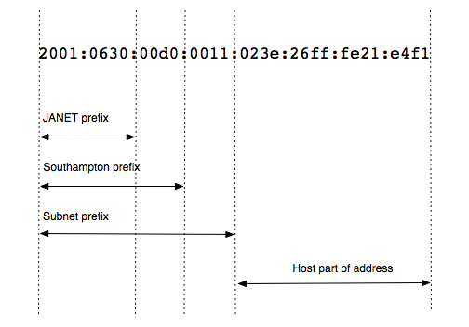
Breaking an address down
IPv6 allocations are made through the RIRs just as they are (or were!) for IPv4
  The default IPv6 allocation to an ISP is a /32 IPv6 prefix, e.g. Janet has 2001:630::/32
  A larger ISP, such as Sky UK, can obtain a larger block of address space
A typical prefix breakdown for a university site might be:

Slide 18
Header comparison
0
15
16
31
Removed (6)
vers hlen TOS total length
identification flags flag-offset
ID, flags, flag offset
TOS, hlen
header checksum
20
bytes
TTL protocol header checksum
source address
destination address
Changed (3)
options and padding
total length => payload
protocol => next header
TTL => hop limit
IPv4
vers traffic class flow-label
Added (2)
payload length next header hop limit
traffic class
flow label
40
bytes
source address
Expanded
destination address
address 32 to 128 bits
IPv6

Slide 19
Version---Indicates the version of IP currently used.
IP Header Length (IHL)---Indicates the datagram header length in 32-bit words.
Type-of-Service---Assigns datagrams various levels of importance.
Total Length---Specifies the length, in bytes, of the entire IP packet.
Identification---Contains an integer that identifies the current datagram.
Flags---The two low-order (least-significant) bits control fragmentation. The low-order bit specifies whether the packet can be fragmented. The middle bit specifies whether the packet is the last fragment in a series of fragmented packets. The third or high-order bit is not used.
Fragment Offset---Indicates the position of the fragment's data relative to the beginning of the data in the original datagram.
Time-to-Live---Maintains a counter that gradually decrements down to zero, at which point the datagram is discarded. This keeps packets from looping endlessly.
Protocol---Indicates which upper-layer protocol receives incoming packets after IP processing is complete.
Header Checksum---Helps ensure IP header integrity.
Source Address---Specifies the sending node.
Destination Address---Specifies the receiving node.
Options---Allows IP to support various options, such as security.
Data---Contains upper-layer information.

Slide 20
Major Improvements of
IPv6 Header
No option field: Replaced by extension header. Result in a fixed length, 40-byte IP header.
No header checksum: Result in fast processing.
No fragmentation at intermediate nodes: Result in fast IP forwarding.

Slide 21
Extension Headers
Routing – Extended routing, like IPv4 loose list of routers to visit
Fragmentation – Fragmentation and reassembly
Authentication – Integrity and authentication, security
Encapsulation – Confidentiality
Hop-by-Hop Option – Special options that require hop-by-hop processing
Destination Options – Optional information to be examined by the destination node

Slide 23
Planning an IP Transition
Administrators are reluctant to change from IPv4 to IPv6 because there is a lot to learn.
IPv4 hardware is still functioning.
The Internet is still mostly IPv4, but there is a gradual transition happening where there will be support for both IP versions.
Currently, we must have mechanisms in place to transmit IPv6 traffic over IPv4 connections, but the situation will be reversed in the future.

Slide 24
Using a Dual IP Stack
The simplest way to transition is to run both IP versions.
Windows has been doing this since Windows Server 2008 and Windows Vista.
Use ipconfig /all to see IPv6 configuration.
This allows us to communicate with IPv4 and IPv6 devices at the same time.

Slide 25
Tunneling
Tunneling is the process by which a system encapsulates an IPv6 datagram within an IPv4 packet.
Often used for router-to-router communication when communicating between two IPv6 networks over an IPv4 connection.
© 2013 John Wiley & Sons, Inc.

Slide 26
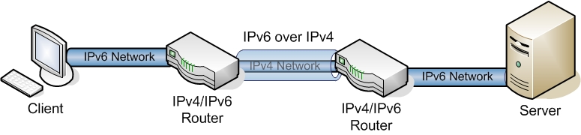
Tunneling
Two IPv6 networks connected by an IPv4 tunnel

Slide 27
Stateless Address Autoconfiguration
3 ways to configure network interfaces: Manually, Stateful, Stateless
IPSAA→ IPv6 addr. Separated into 2 2 parts: network and interface id.
Link- local addresses: prefix FE80::0 + interface identifier (EUI-64 format)
Obtain network id through Router solicitation (RS)

Slide 28
Conclusion
IPv6 is NEW …
– built on the experiences learned from IPv4
– new features
– large address space
– new efficient header
– autoconfiguration
… and OLD
– still IP
– build on a solid base
– started in 1995, a lot of implementations and tests done

Slide 29
References
IPng wg: http://playground.sun.com/pub/ipng/html
NGtrans: http://www.6bone.net/ngtrans
IPv6 users site: http://www.ipv6.org
IPv6 Forum: http://www.ipv6forum.com
Normos (Internet standards): http://www.normos.org

Slide 30
Any Questions??

